Slide 1

Melanoma cancer detection

Slide 2
GROUP MEMBERS
BDM 3023
3104 - Neural Networks and Deep Learning 01
Aishwarya Ganesan
Harshik Patel
Kavit Soni
Dhruv Ajmeri
Meet Patel

Slide 3
Abstract
In cancer, there are over 200 different forms. Out of 200, melanoma is the deadliest form of skin cancer. The diagnostic procedure for melanoma starts with clinical screening, followed by dermoscopic analysis and histopathological examination. Melanoma skin cancer is highly curable if it gets identified at the early stages. The first step of Melanoma skin cancer diagnosis is to conduct a visual examination of the skin's affected area. Dermatologists take the dermatoscopic images of the skin lesions by the high-speed camera, which have an accuracy of 65-80% in the melanoma diagnosis without any additional technical support. With further visual examination by cancer treatment specialists and dermatoscopic images, the overall prediction rate of melanoma diagnosis raised to 75-84% accuracy. The project aims to build an automated classification system based on image processing techniques to classify skin cancer using skin lesions images.

Slide 4
Problem Statement
In the skin biopsy, the dermatologist takes some part of the skin lesion and examines it under the microscope. The current process takes almost a week or more, starting from getting a dermatologist appointment to getting a biopsy report. The aims to shorten the current gap to just a couple of days by providing the predictive model. The approach uses Convolutional Neural Network (CNN) to classify nine types of skin cancer from outlier lesions images. This reduction of a gap has the opportunity to impact millions of people positively.

Slide 5
Motivation
The overarching goal is to support the efforts to reduce the death caused by skin cancer. The primary motivation that drives the project is to use the advanced image classification technology for the well-being of the people. Computer vision has made good progress in machine learning and deep learning that are scalable across domains.

Slide 6
Dataset
The dataset consists of 2357 images of malignant and benign oncological diseases, which were formed from the International Skin Imaging Collaboration (ISIC). All images were sorted according to the classification taken with ISIC, and all subsets were divided into the same number of images.

Slide 7
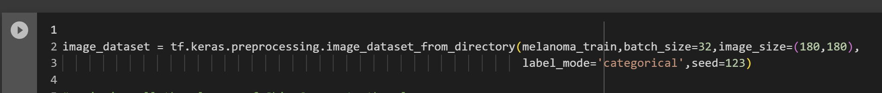
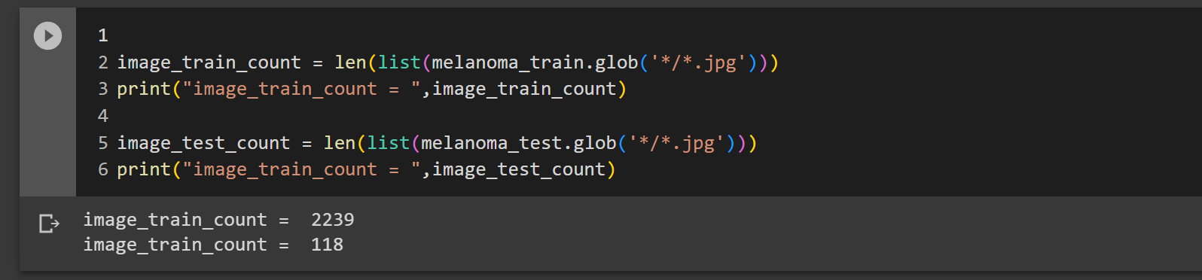
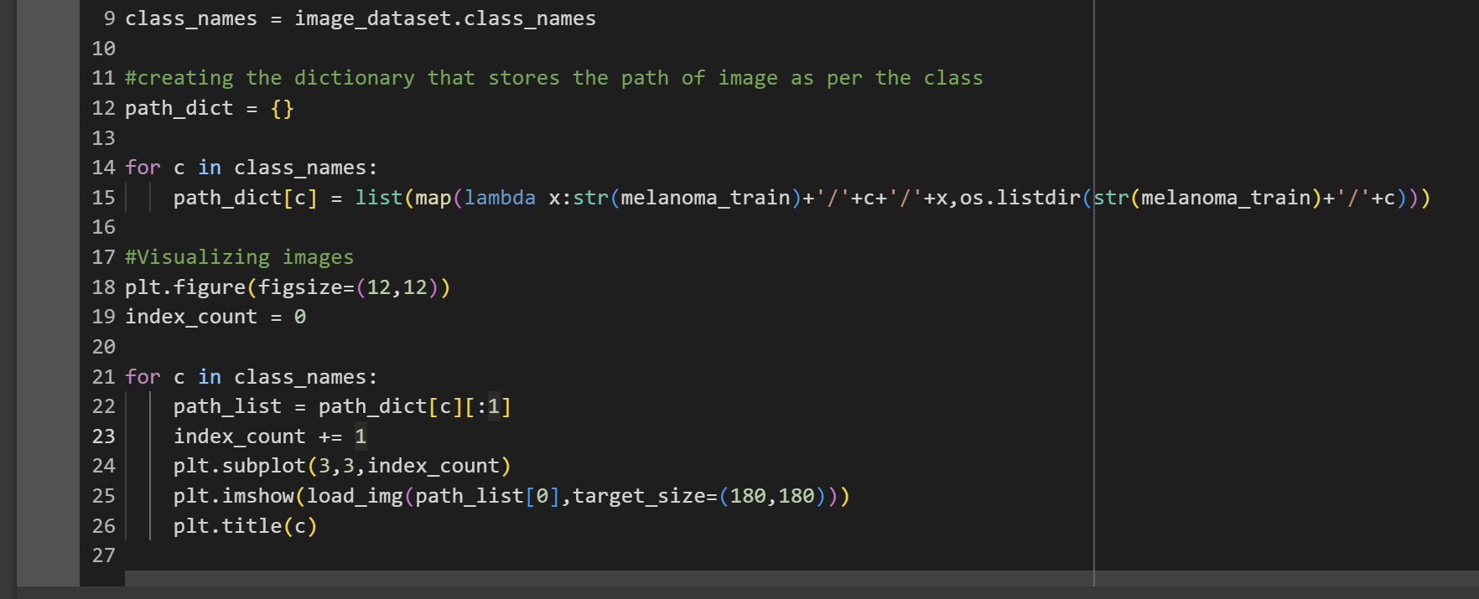
Image preprocessing and visualization
This part of the code uses the tf.keras.preprocessing.image_dataset_from_directory function to create a TensorFlow dataset from the training images. The function creates batches of images, resizes them to a common size (180x180 pixels), and converts the labels to categorical format. It also seeds the randomization for reproducibility.
Counting the number of images in Train and Test dataset and assigning to the variables
Visualizing one instance of all the classes present in the dataset.
The function image_dataset_from_dictionary() will produce a tf.data.Dataset that provides sets of image batches originating from the subdirectories.
If label_mode is set to "categorical", the labels will be represented as a float32 tensor with a shape of (batch_size, num_classes), which corresponds to a one-hot encoding of the class index.

Slide 8
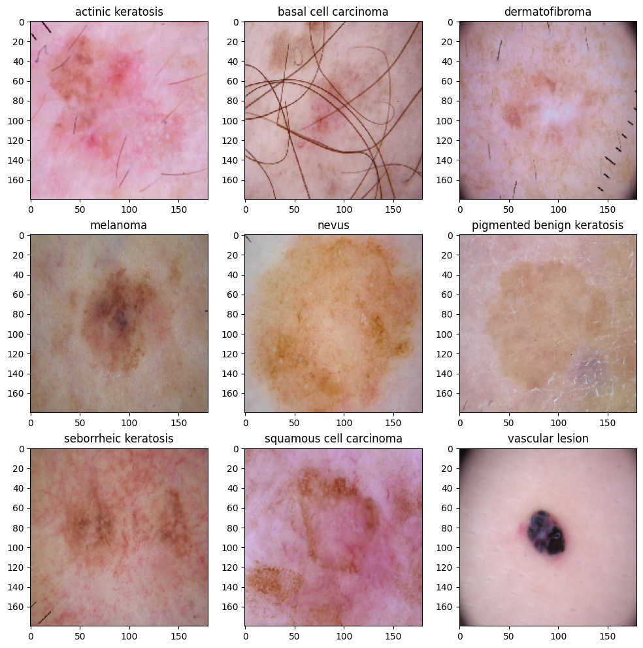

Slide 9
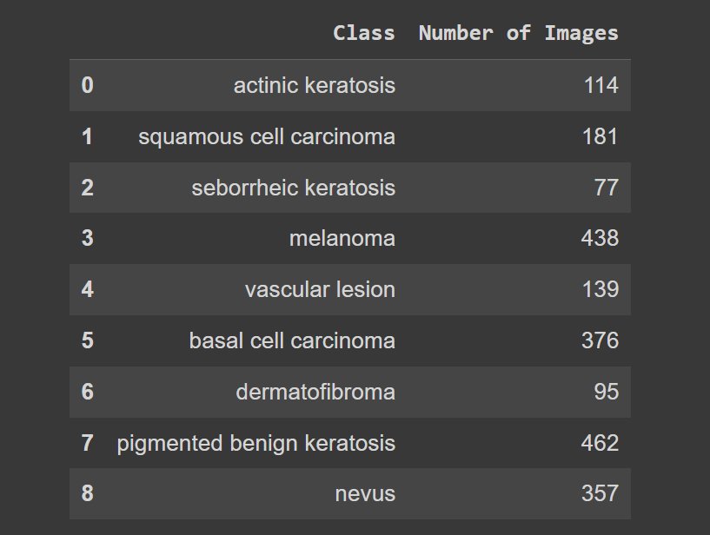
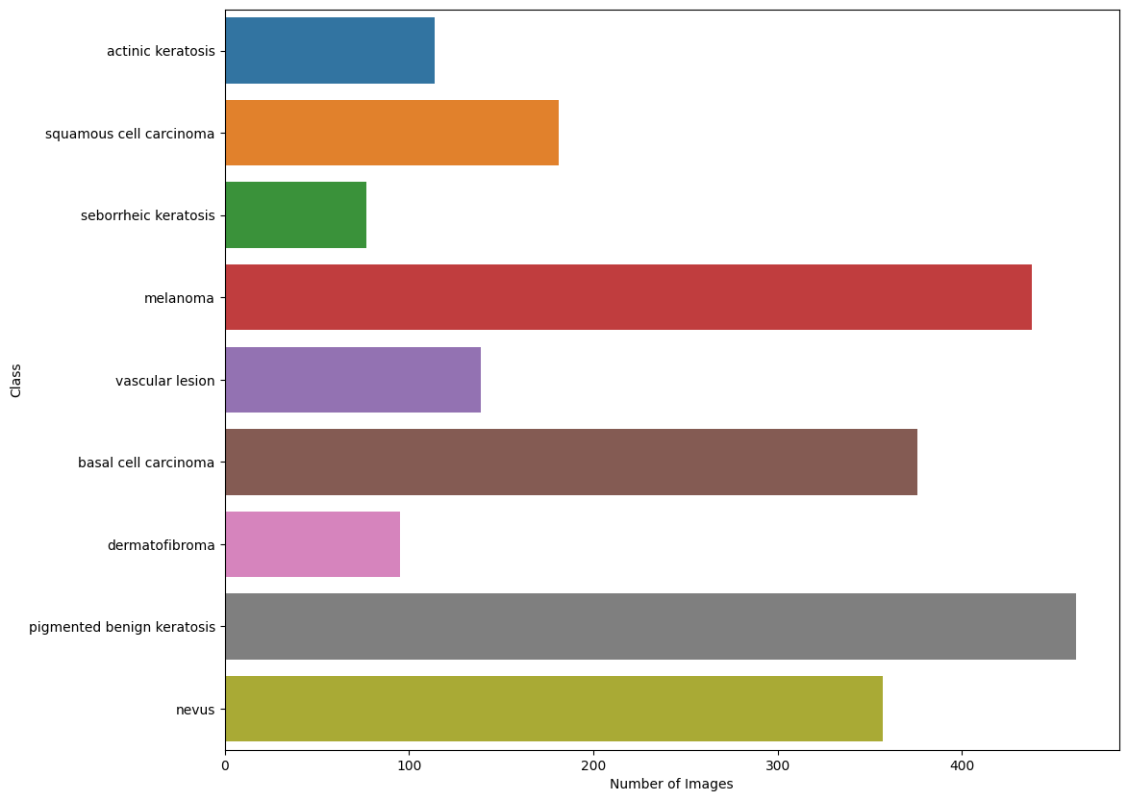
Image preprocessing and visualization
Visualizing the Number of image in each class.

Slide 10
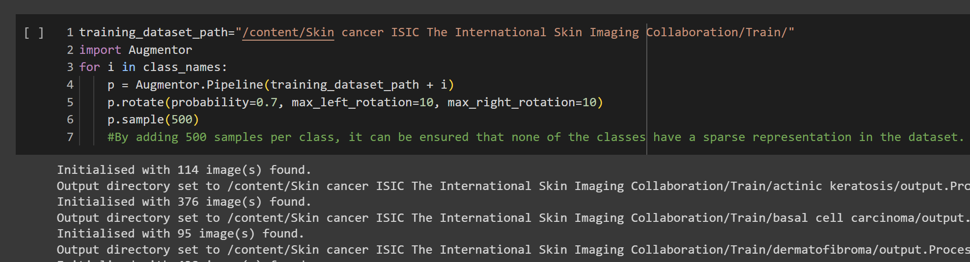
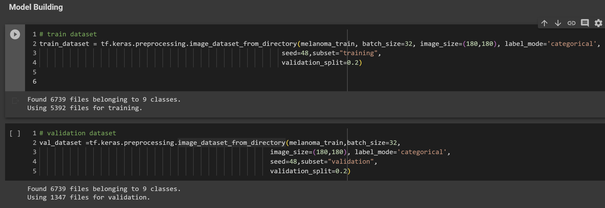
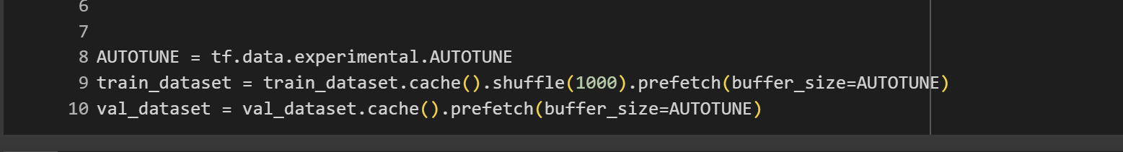
Augmentation & Model Building
Uses the Augmentor library to apply data augmentation techniques such as rotation to increase the dataset size.
Data augmentation involves applying various transformations to your training images to artificially increase the diversity of your dataset, which helps the model generalize better and reduces overfitting.
Creates train and validation datasets, splitting the training data using the subset and validation_split parameters.
Autotune optimizes the data pipeline using caching and prefetching to speed up data loading during training.
tf.data.experimental.AUTOTUNE defines appropriate number of processes that are free for working

Slide 11
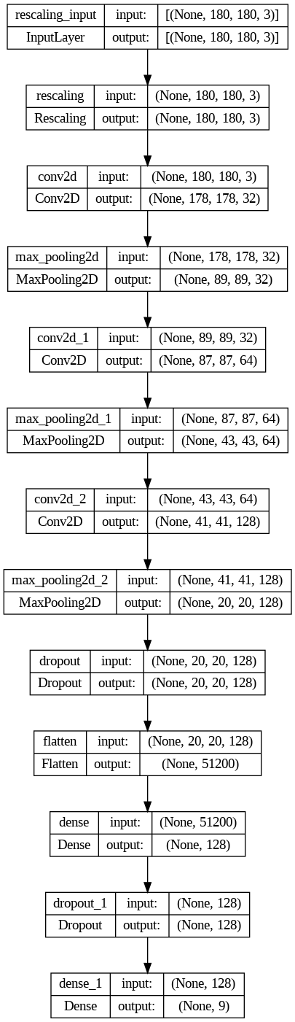
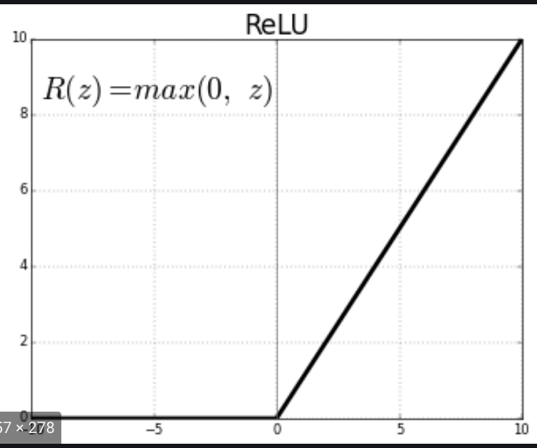

Slide 12
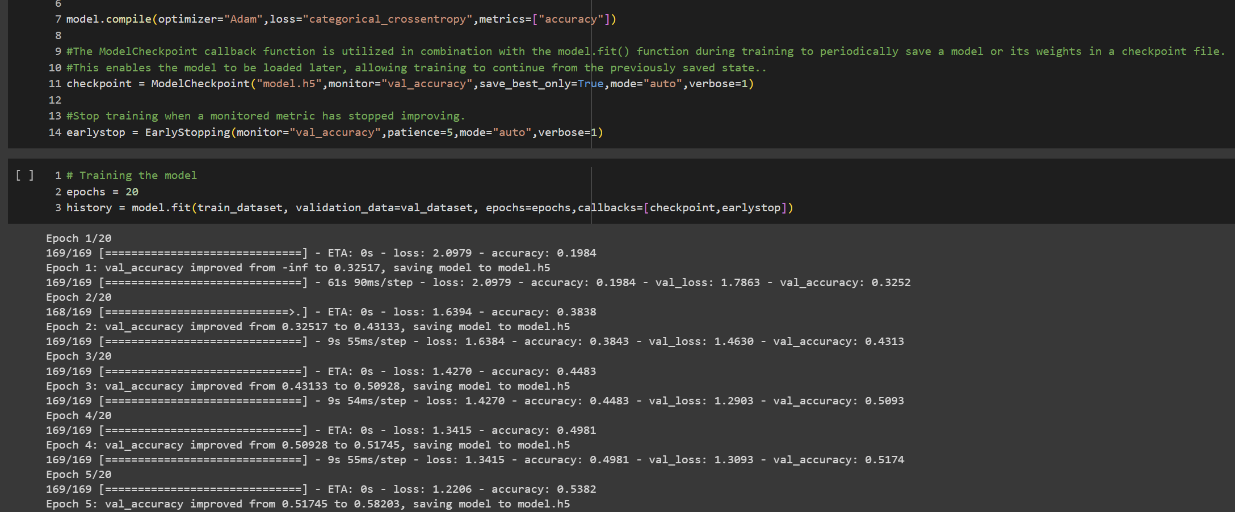
Model compilation and training
The Adam optimization algorithm is a type of stochastic gradient descent that employs adaptive estimation of the first and second moments to update the parameters of a neural network
This enables the algorithm to optimize the network more efficiently by adjusting the learning rate of each weight parameter based on the magnitude of its gradients

Slide 13
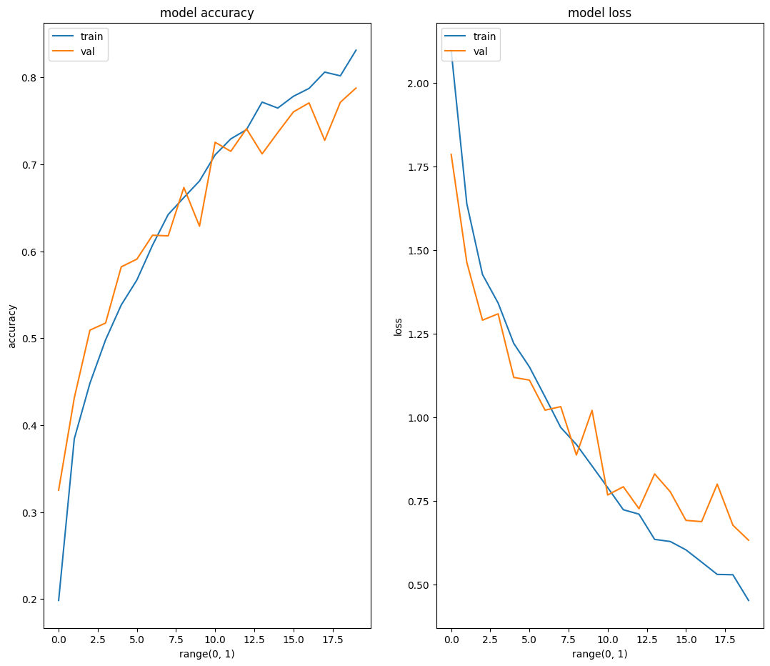

Slide 14
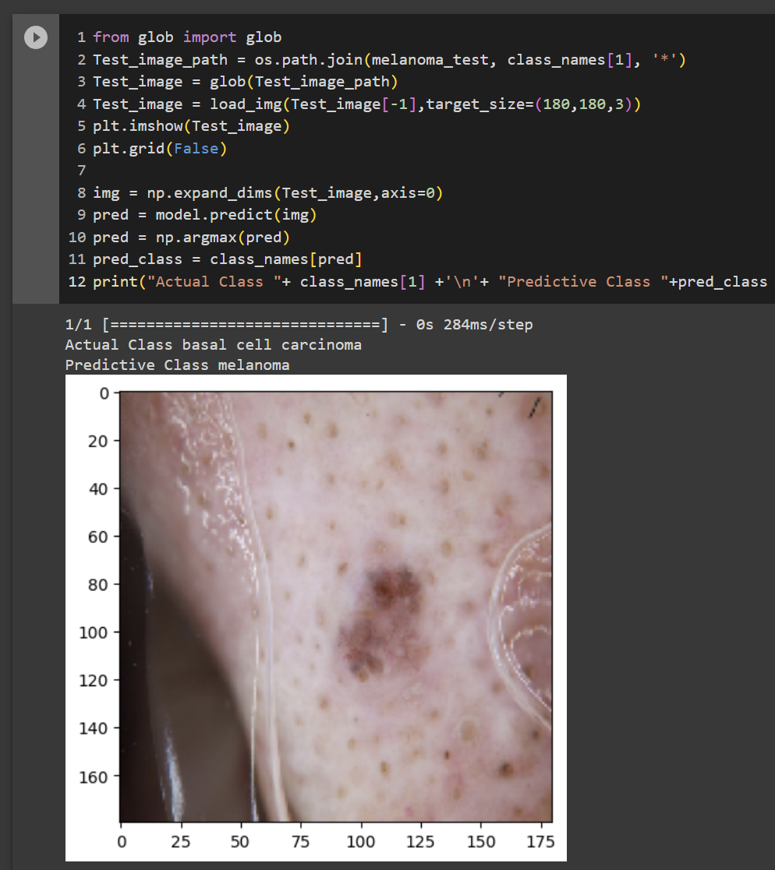
Cancer class prediction

Slide 15
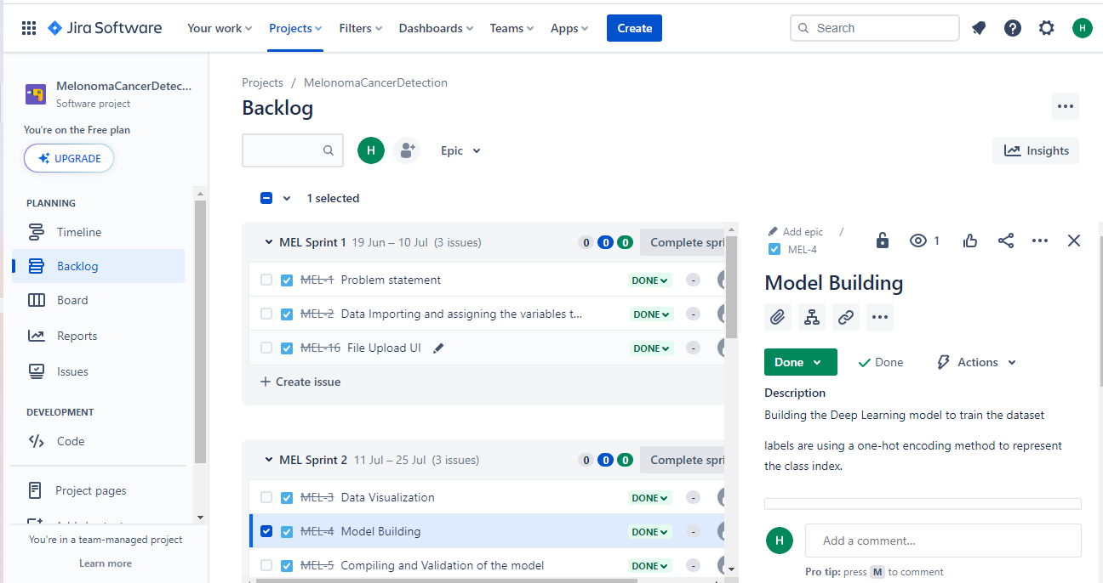
USER STORIES

Slide 16
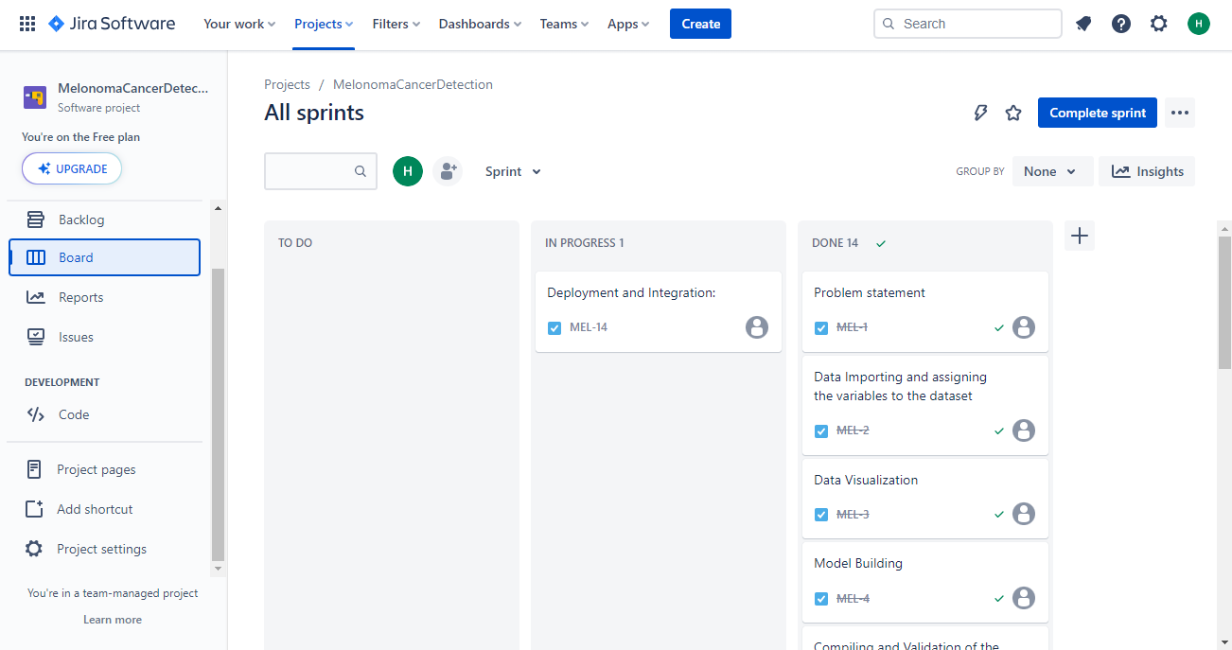
USER STORIES

Slide 17
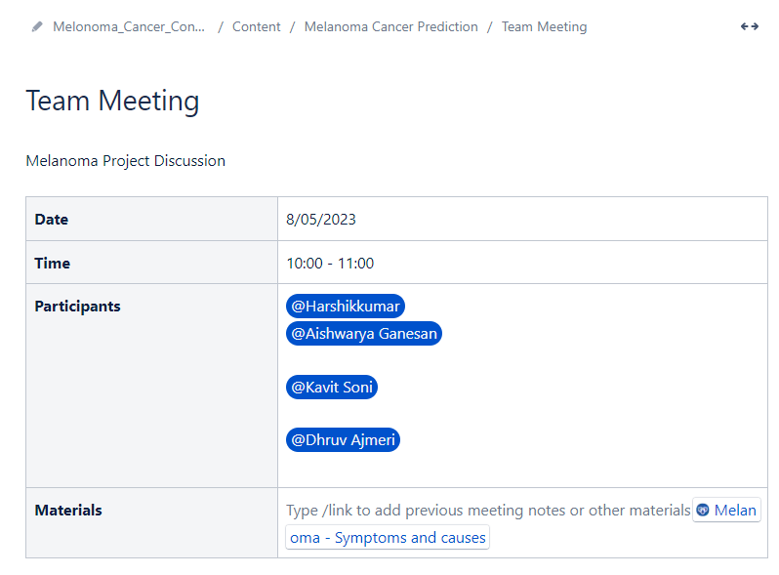
Confluence

Slide 18
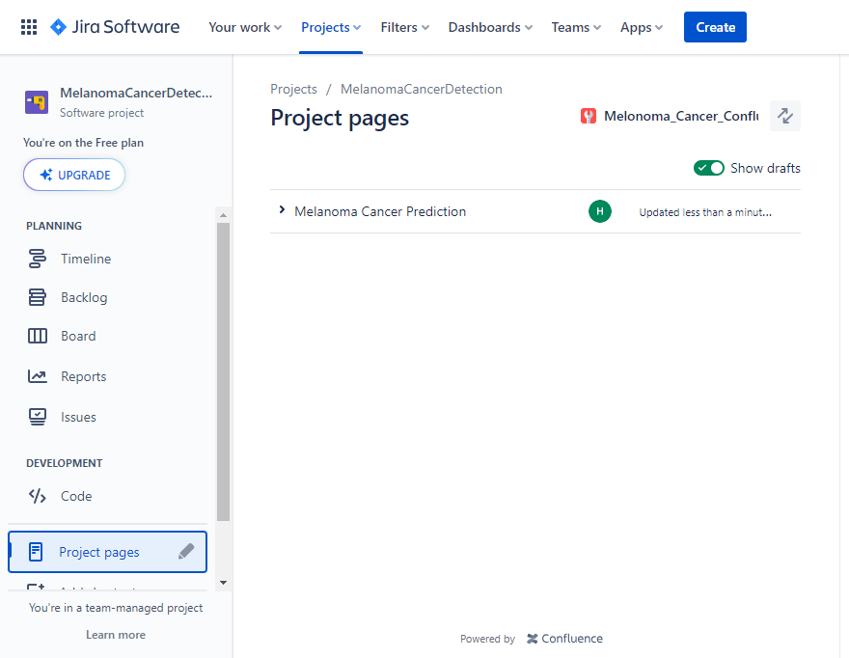
Integrated JIRA With confluence

Slide 19
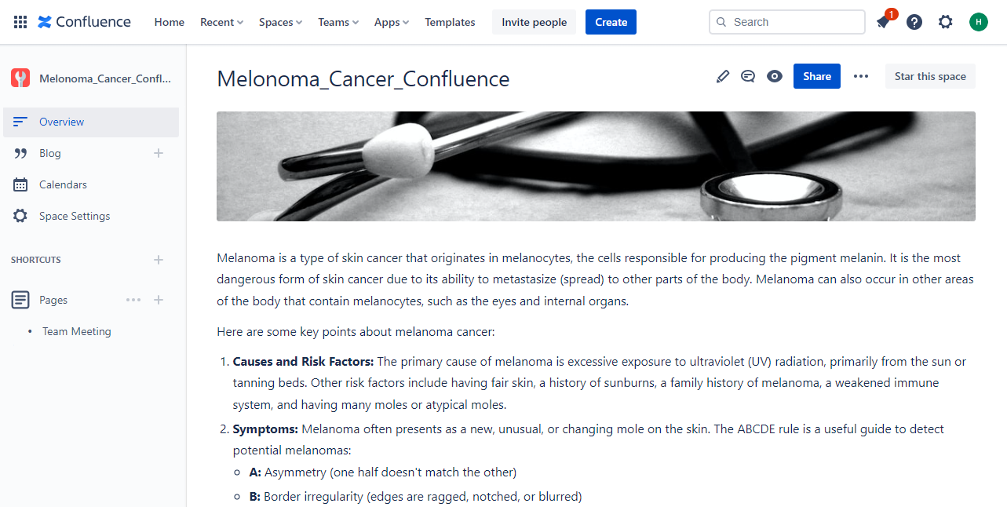
Pages

Slide 20
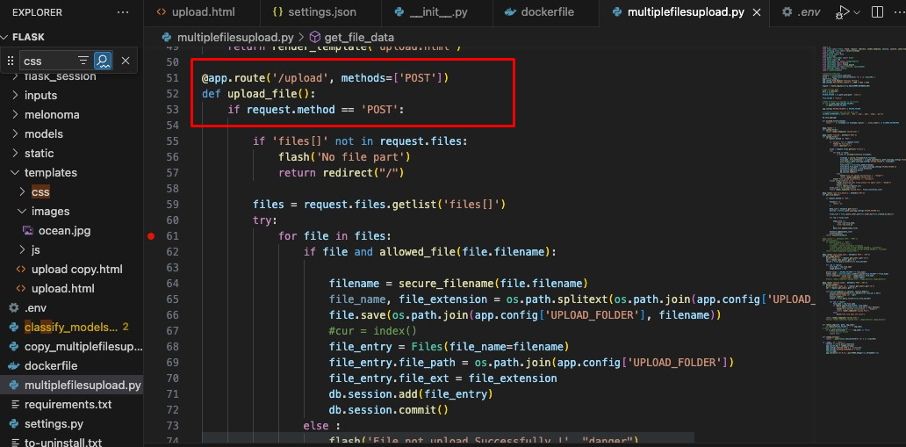
UPLOAD FLASK API : POST Request

Slide 21
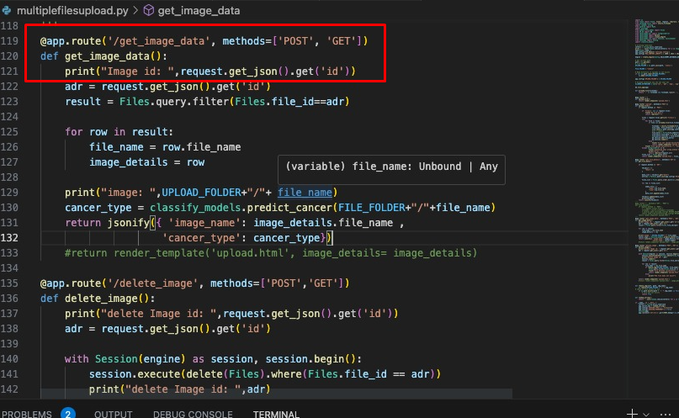
VIEW IMAGE API and Predict class

Slide 22
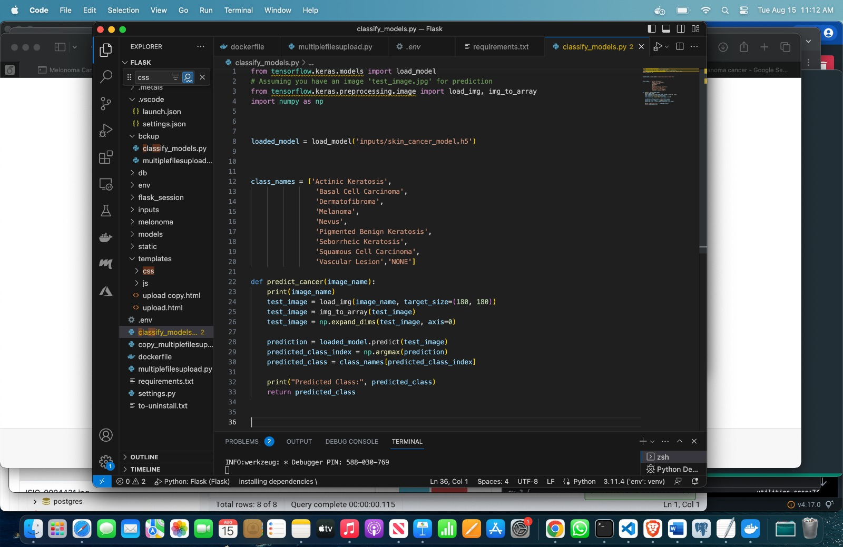
Predict class method

Slide 23
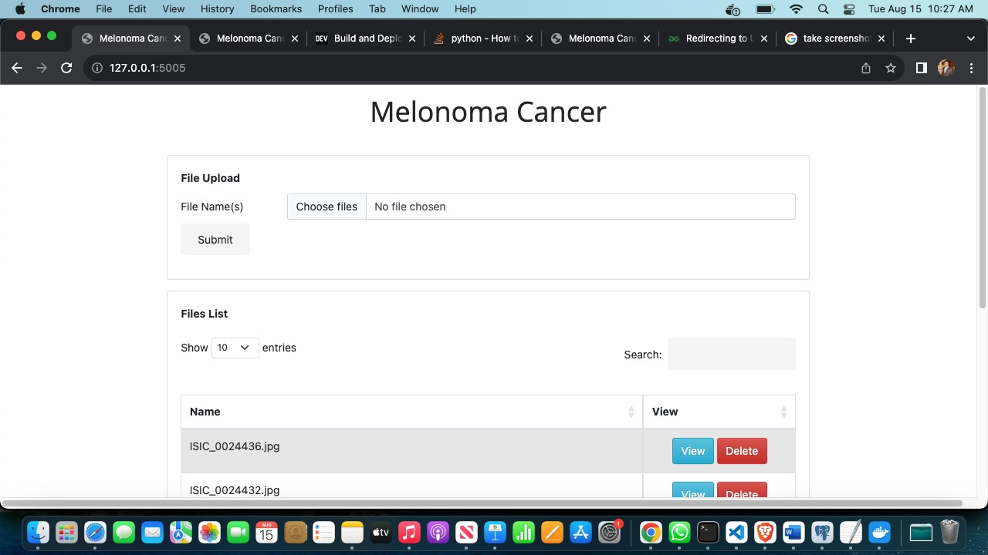
User Interface

Slide 24
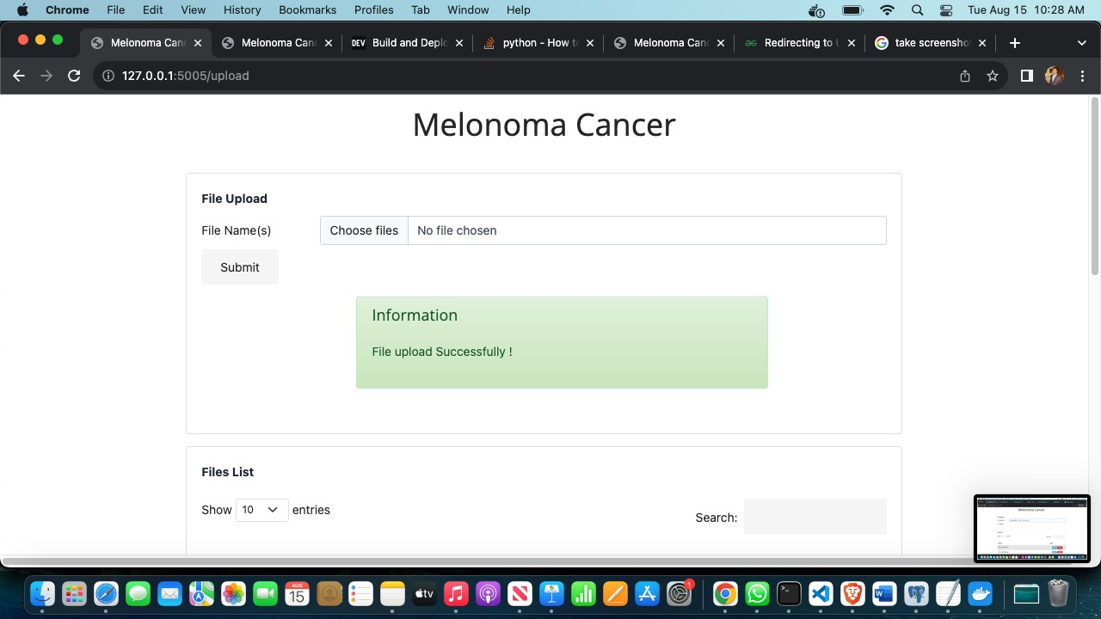
Upload Image File

Slide 25
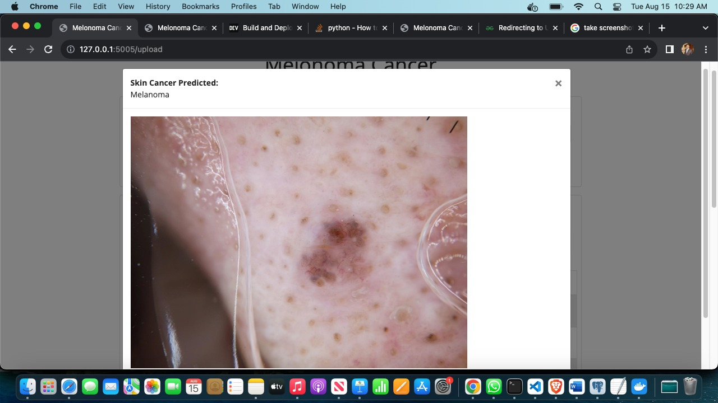
View IMAGE

Slide 26
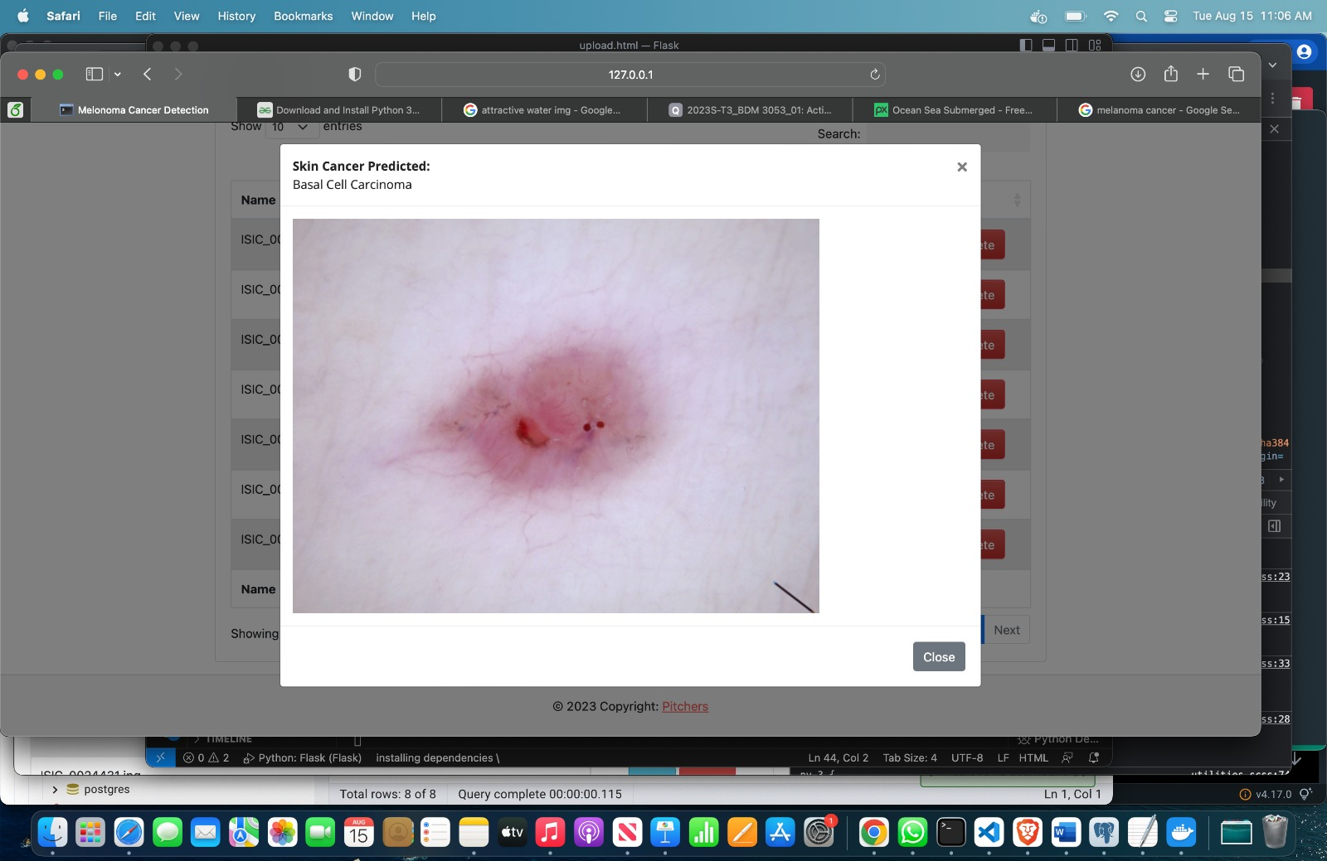
View IMAGE

Slide 27
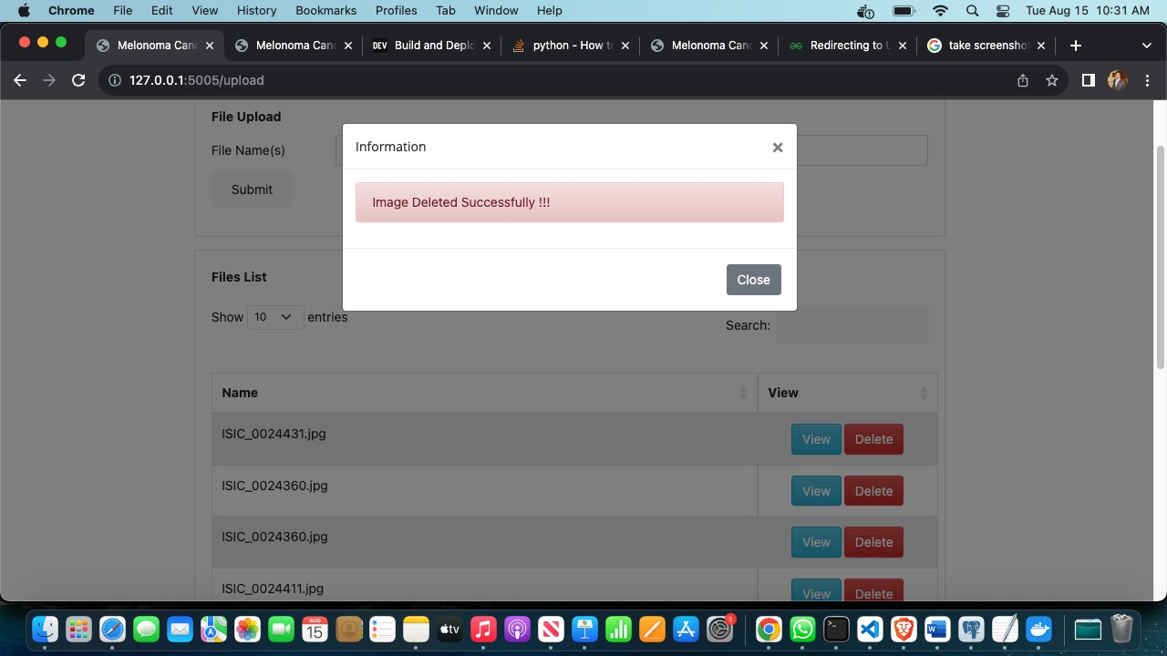
DELETE IMAGE

Slide 28
THANK YOU

